Slide 1

Twitter Clone
Design Notes

Slide 2
Actions
Research ActiveStorage for profile pics and such
Research modelling for message conversation

Slide 3

Rails Notes

Slide 4
Rails & Backend Considerations
API vs. Vanilla setup
Go with API – easier than trying to mix in React into Rails
Models & database
Users (Devise)
Tweets
Replies
Retweets
Quote Tweets
Likes
Notifications
Messages
Database – PG vs. SQLite (depends on deployment

Slide 5


User Model
Associations
Has_many Tweets
Has_many Replies
Has_many Retweets
Has_many Likes
Has_many Notifications
Column Name | Validation
email:string | Present, length <=320
name:string | Present, Length >=4, <=30
bio:text | Length < 160
username:string | Present, length <=50
location:string
website:url?
birthday:date | Value <= (today – 10y)
profile_pic:?
header_pic:?

Slide 6

Tweet Model
Associations
Belongs_to User
Has_many Replies
Has_many Retweets
Has_many QuoteTweets
Has_many Likes
Column Name | Validation
Content:Text | Present, Length <=280
User:References | Present

Slide 7

Reply Model
Associations
Belongs_to User
Belongs_to Tweet
Column Name | Validation
Content:Text | Present, Length <=280
User:References | Present
Tweet:References | Present

Slide 8

Retweet Model
Associations
Belongs_to User
Belongs_to Tweet
Column Name | Validation
User:References | Present
Tweet:References | Present

Slide 9

QuoteTweet Model
Associations
Belongs_to User
Belongs_to Tweet
Column Name | Validation
Content:Text | Present, Length <=280
User:References | Present
Tweet:References | Present

Slide 10

Like Model
Associations
Belongs_to User
Belongs_to Tweet
Column Name | Validation
User:References | Present
Tweet:References | Present

Slide 11
Relationship Model
Associations
Belongs_to Follower, class_name “User”
Belongs_to Followed, class_name “User”
Column Name | Validation
Follower:References | Present
Followed:References | Present

Slide 12

Notification Model
Associations
Belongs_to User
Column Name | Validation
User:references | Present
Content:Text | Length < 22
Type:Text
Read:Boolean | Default:False
Notification type can be things like tweet likes, retweets, etc. This will change the icon of the notification.

Slide 13


Message Model
Figure out this model
Associations
Belongs_to Sender, class_name “User”
Belongs_to Receiver, class_name “User”
Belongs_to Conversation
Column Name | Validation
User:references | Present
Content:Text | Length < 22
Read:Boolean | Default:False

Slide 14

Conversation Model
Figure out this model
Associations
Belongs_to Sender, class_name “User”
Belongs_to Receiver, class_name “User”
Belongs_to Conversation
Column Name | Validation
User:references | Present
Content:Text | Length < 22
Read:Boolean | Default:False

Slide 15

React Notes

Slide 16
Home - Primary Components
Sidebar
Feed
Suggestions

Slide 17
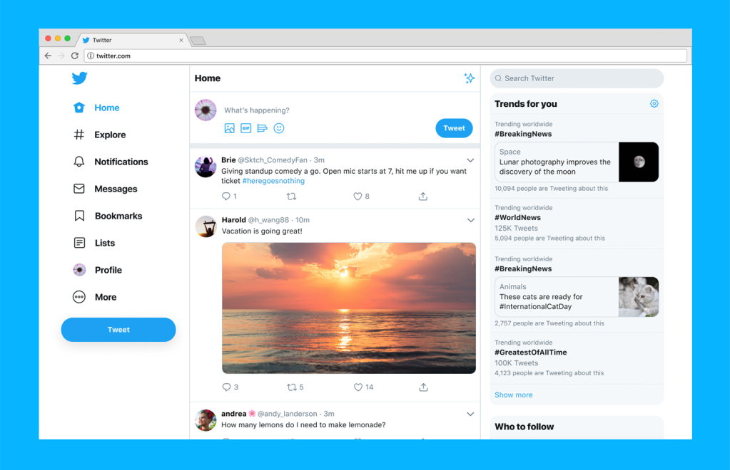

Slide 18
Sidebar
Feed
Suggestions

Slide 19
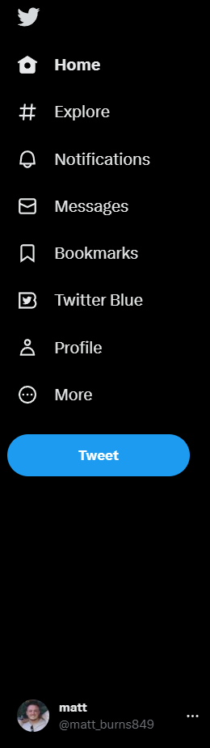
Labels hide when total screen reaches minimum width
All 3 primary elements are fixed width until reaches smalles size
When screen size < (sidebar + feed + suggestions):
Labels { display: none }

Slide 20

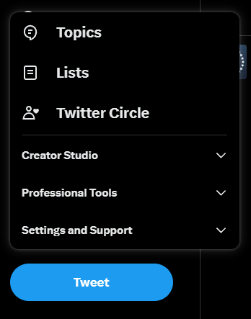


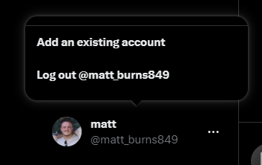


SidebarTop
SidebarLogo
SidebarLogo
SideBarModals
SidebarLinkContainer
SidebarLogo:Hover
SidebarLink:hover
SidebarLinkIcon
SidebarLinkLabel
SidebarTweetBtn
SidebarBottom

Slide 21
Icons:
Logo
Home
Explore (hashtag)
Notifications (bell)
Messages (mail)
Bookmark
Twitter Blue
Profile
More

Slide 22
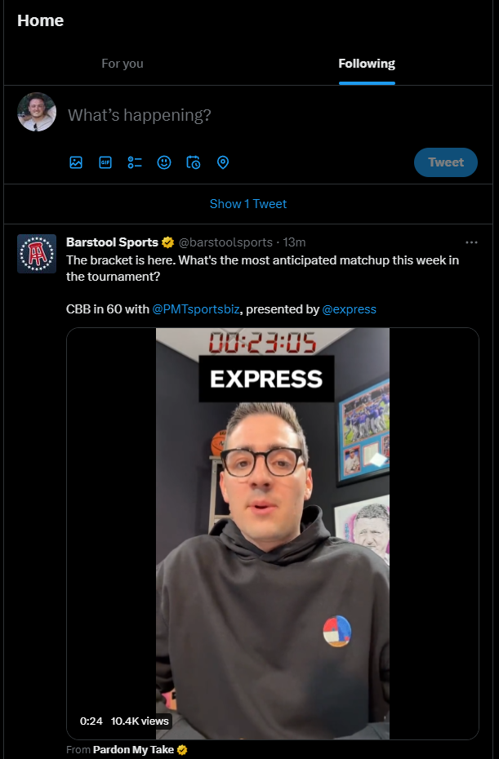
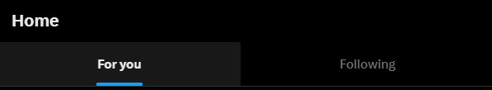
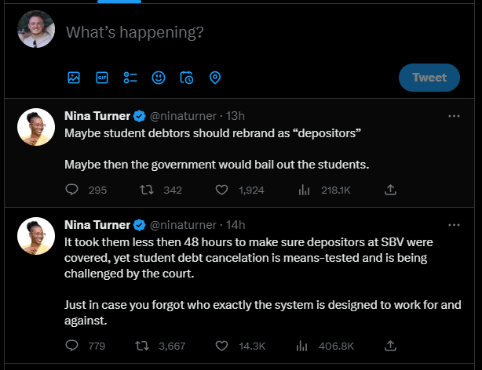
FeedTop
FeedNewTweet
FeedTweets

Slide 23
TweetProfilePic
TweetRight
TweetRight
TweetAuthorInfo
TweetContent
Min-height
TweetActions

Slide 24
TweetUserInfo
TweetInfoLeft
vv
TweetInfoRight
TweetAuthorName
TweetAuthorUsername
vv
vv
TweetRelativeTime
TweetMoreInfo

Slide 25
TweetActions
1
2
3
4
5
Padding (no height)
Flex Flex-Start
TweetActionIcon
TweetActionCount

Slide 26
TweetProfilePic
TweetRight
TweetAuthorInfo (blank)
TweetContent (as a form)
Min-height
TweetActionsNew
Padding (no height)

Slide 27
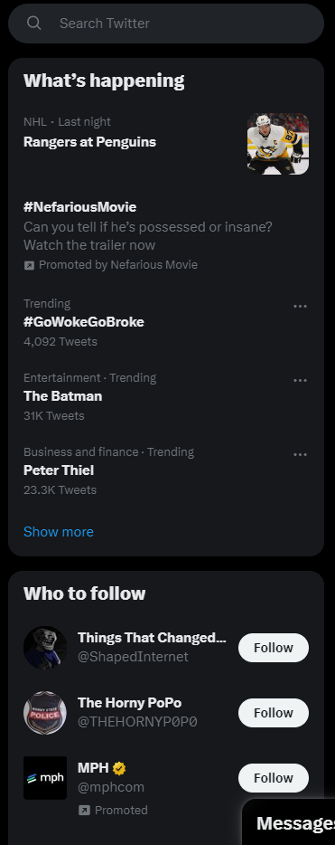
SearchBar
SuggestedTrendsList
SearchIcon
SearchText
SuggestedTrendTitle
SuggestedTrendTop
SuggestedTrendMiddle
SuggestedTrendBottom
SuggestedTrend
SuggestedUsersList

Slide 28
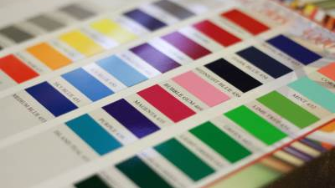
Design & Color

Slide 29
Colors
Background { #000000 }
Item:hover { #181818 }
Primary Blue { #217EEF }
Divider { #2E3235 }
Side Item { #16181C }

Slide 30

Deployment Notes

